Slide 1
Nuclear Fuel Performance
NE-591-010
Spring 2021

Slide 2
Last Time
However, the ratio of oxygen to uranium can change. We call this the stoichiometry and abbreviate it as O/M ratio
The O/M ratio impacts many properties of the fuel
MOOSE overview

Slide 3
grain growth

Slide 4
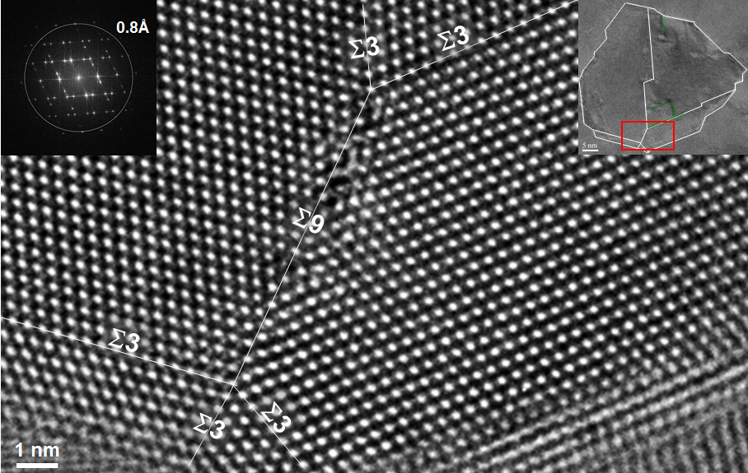
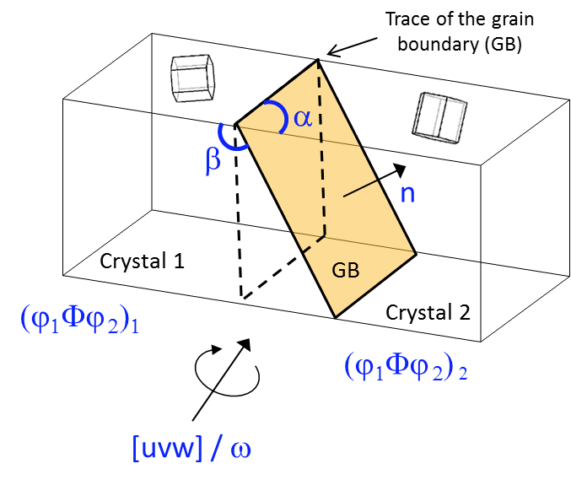
Grain Boundaries
Materials are typically composed of various regions where the crystal lattice is oriented differently
When two grains meet, there is a plane of atoms that do not follow the crystal lattice called a grain boundary
Grain boundaries add energy to the material that is a function of their structure
A grain boundary’s energy is determined by its:
Inclination – the orientation of the 2D grain boundary plane (2 degrees of freedom)
misorientation – the rotation required to align one grain with the other (3 degrees of freedom)

Slide 5
Grain Texture
The orientation of all the grains in a material is called the texture
The degree of texture is dependent on the percentage of crystals having a preferred orientation
randomly oriented grains equals no texture
Texture is seen in almost all engineered materials, and can have a great influence on materials properties

Slide 6
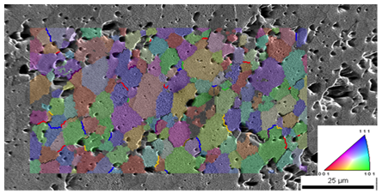
Grain size
In a polycrystal, there is also a distribution of grain sizes
The average grain size of the fuel has a significant impact on its behavior
Typical LWR fuel has an initial average grain size of about 10 microns
The average grain size impacts
Fission gas release
Swelling
Thermal conductivity
Creep

Slide 7
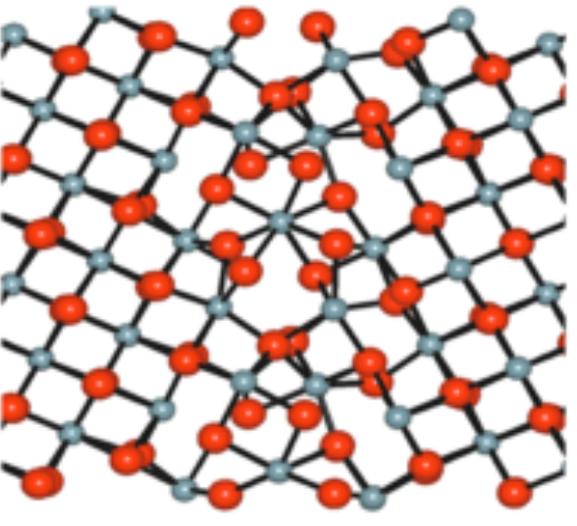
Grain boundary diffusion
Diffusion often occurs faster along grain boundaries than in the perfect crystal
Grain boundaries have more space than the perfect lattice
So, atoms diffuse faster along grain boundaries than through the perfect lattice
This means that grain boundary, or intergranular, diffusion increasingly dominates bulk (intragranular) diffusion as the temperature is reduced
Grain boundary vacancy diffusion has a large impact on creep

Slide 8
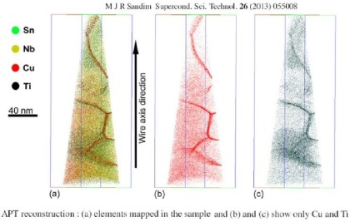
Grain boundary segregation
Impurity atoms (such as fission gas) and other defects move to grain boundaries
Due to grain boundaries having more open space, impurity atoms have a lower energy when they are on grain boundaries.
This is called grain boundary segregation
Radiation induced segregation (RIS) is where radiation produces defects that drive towards the grain boundary and preferentially drag solute atoms

Slide 9
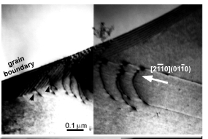
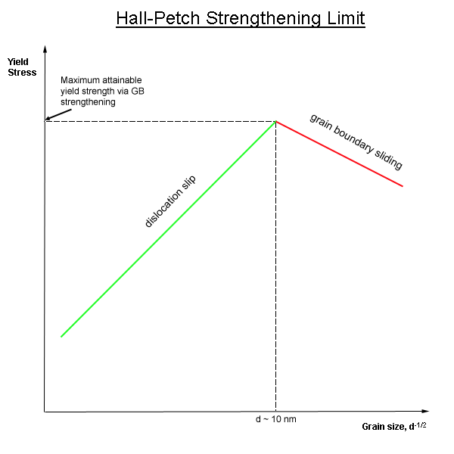
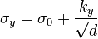
Dislocation interaction with grain boundaries
Grain boundaries impede dislocation motion
The number of dislocations within a grain impacts how easily dislocations can traverse grain boundaries and travel from grain to grain.
So, by changing grain size one can influence dislocation movement and yield strength
This is called the Hall-Petch effect
where σ_{y} is the yield stress, σ₀ is a materials constant for the starting stress for dislocation movement (or the resistance of the lattice to dislocation motion), k_{y} is the strengthening coefficient (a constant specific to each material), and d is the average grain diameter

Slide 10
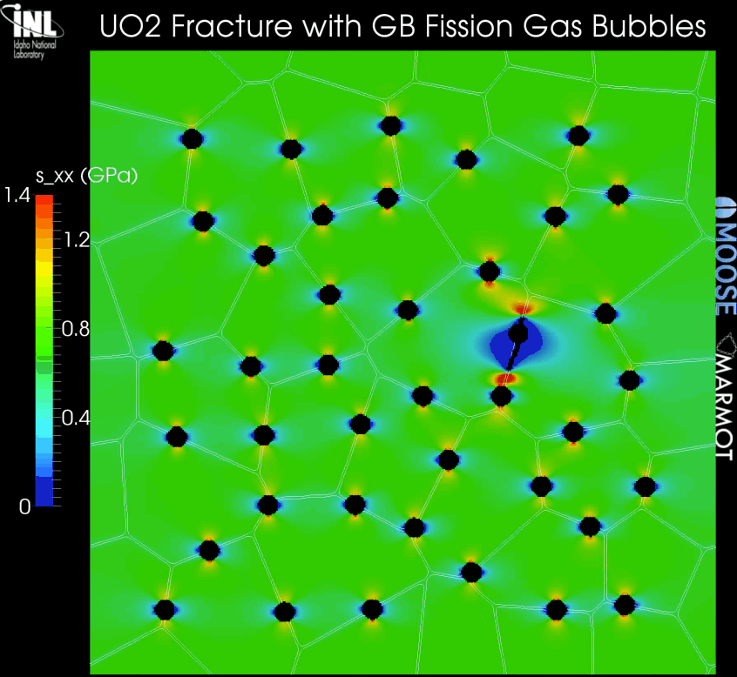
Grain boundaries and cracks
Materials often crack along grain boundaries
Grain boundaries can be weaker than the perfect lattice
different bonding environment, increased extrinsic particles, etc.
Thus, fracture will often occur along grain boundaries (intergranular fracture)

Slide 11
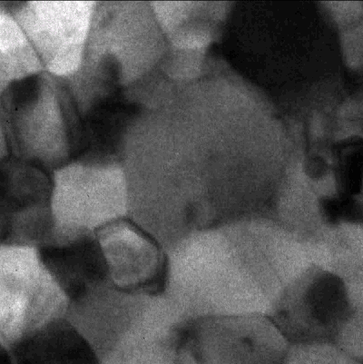
Grain size change
A single crystal has a lower energy state than a polycrystal, due to the grain boundary energy
So, grain boundaries migrate to reduce the energy
v_{GB} = M_{GB} (P_{d} – P_{r})
M_{GB} is the grain boundary mobility
P_{d} is the driving force (pressure) for grain growth
P_{r} is the pressure resisting grain growth

Slide 12
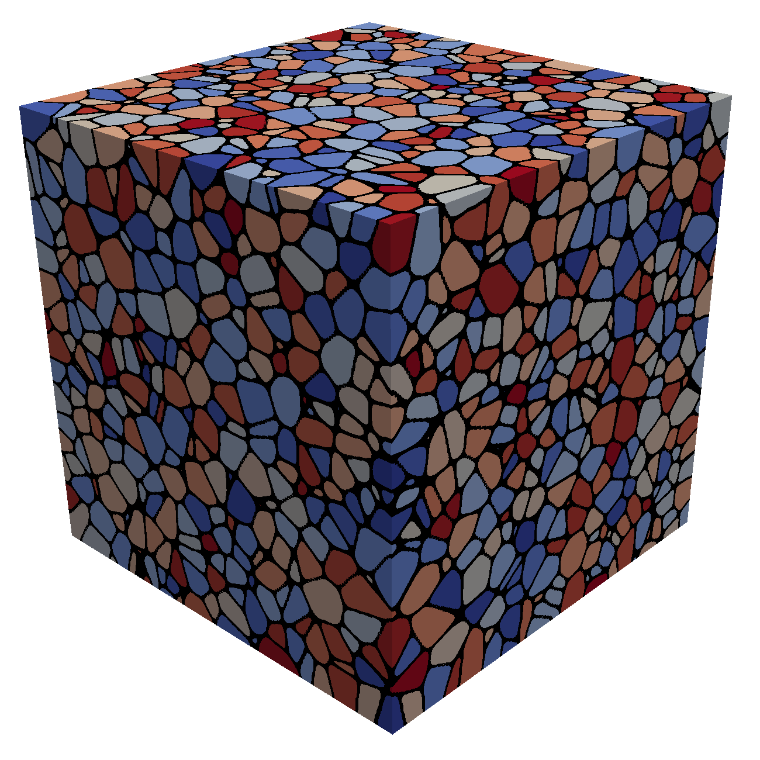
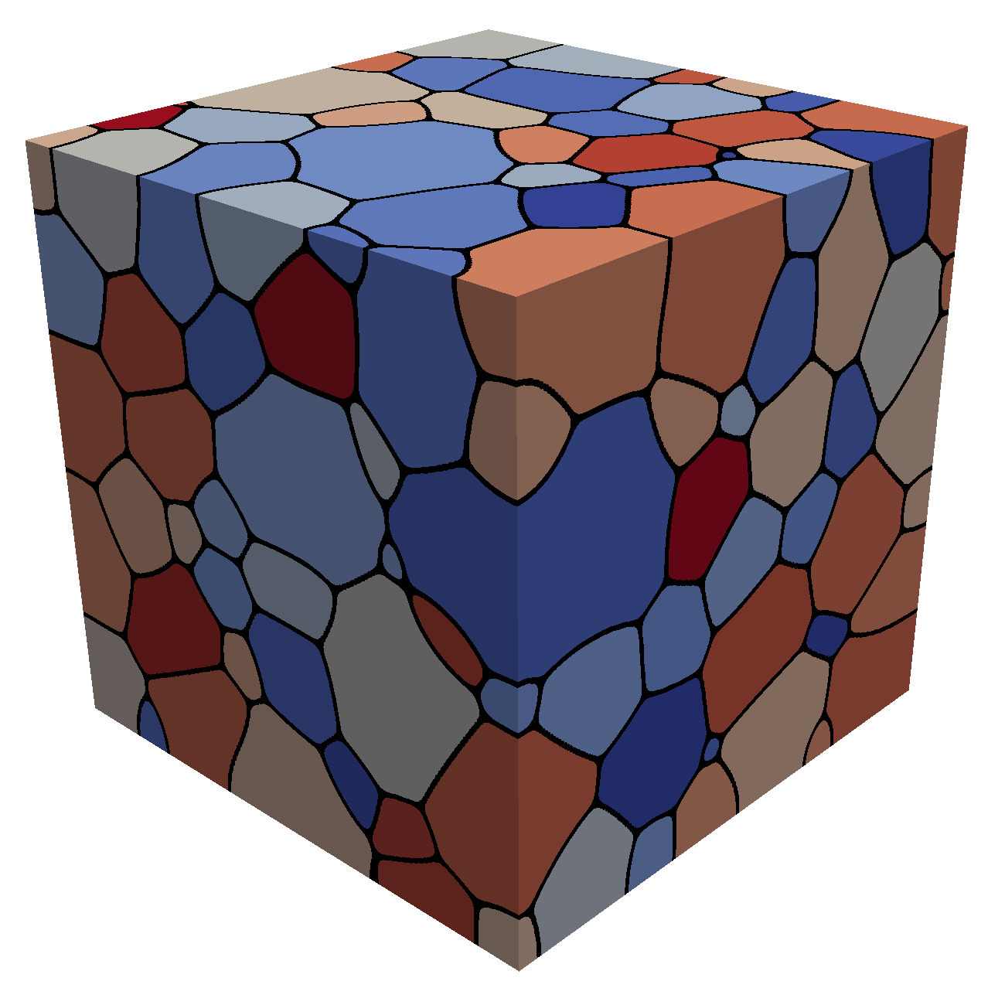
Grain growth
Due to grain boundary migration, the average grain size goes up with time during annealing/heat treating
As grain boundaries migrate, some grains grow and some shrink
Shrinking grains eventually disappear
The average grain volume
Therefore, as N_{grains} decreases due to grain disappearance, the average grain volume goes up

Slide 13
Grain boundary mobility
The grain boundary mobility is a function of temperature and GrB type
The grain boundary mobility is determined according to
m⁴/(J s)
k_{b} = 8.6173e-5 eV/K is the Boltzmann constant
Both the pre-factor M₀ and the activation energy Q change as a function of the grain boundary misorientation
We often use an average grain boundary for a material, taken from polycrystal measurements-> UO2: M₀ (m⁴ /J-s) = 4.6e-09, Q (eV) = 2.77
What is the mobility of UO₂ at 1600 K?
M_{GB} = 4.6e-9*exp(-2.77/(1600*8.6173303e-5)= 8.7e-18 m⁴/J-s

Slide 14
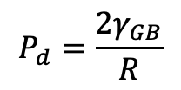
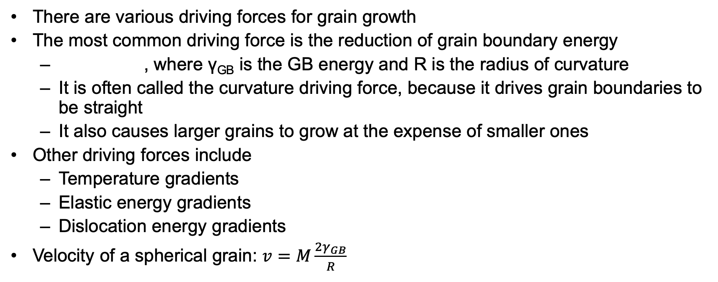
Grain growth
There are various driving forces for grain growth
The most common driving force is the reduction of grain boundary energy
, where γ_{GB} is the GB energy and R is the radius of curvature
It is often called the curvature driving force, because it drives grain boundaries to be straight
It also causes larger grains to grow at the expense of smaller ones
Other driving forces include
Temperature gradients
Elastic energy gradients
Dislocation energy gradients
Velocity of a spherical grain: $v=M\frac{{2γ}_{GB}}{R}$
$$P_{d}=\frac{{2γ}_{GB}}{R}$$

Slide 15
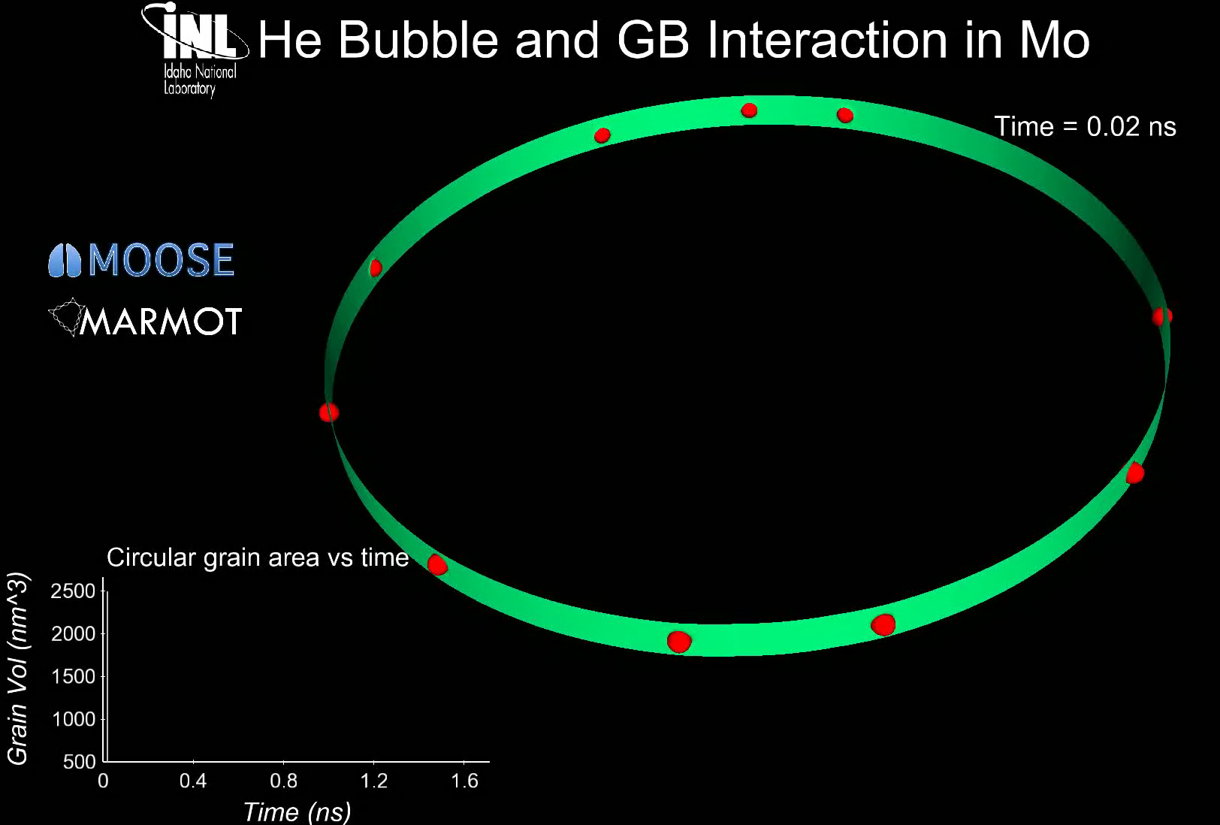
Grain growth
Grain boundary motion is inhibited by pores, precipitates, solute atoms, etc.
Solute atoms (whether in interstitial sites or vacancies) can decrease the grain boundary mobility.
This is called Solute Drag
Even a small concentration of impurities can decrease the mobility by 3 to 4 orders of magnitude
Particles and pores resist grain boundary motion

Slide 16
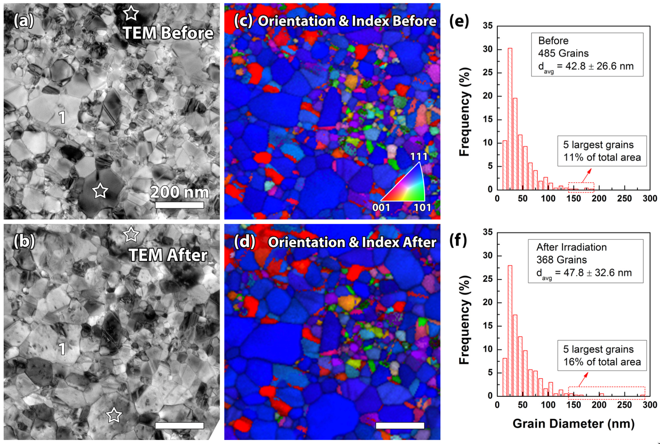
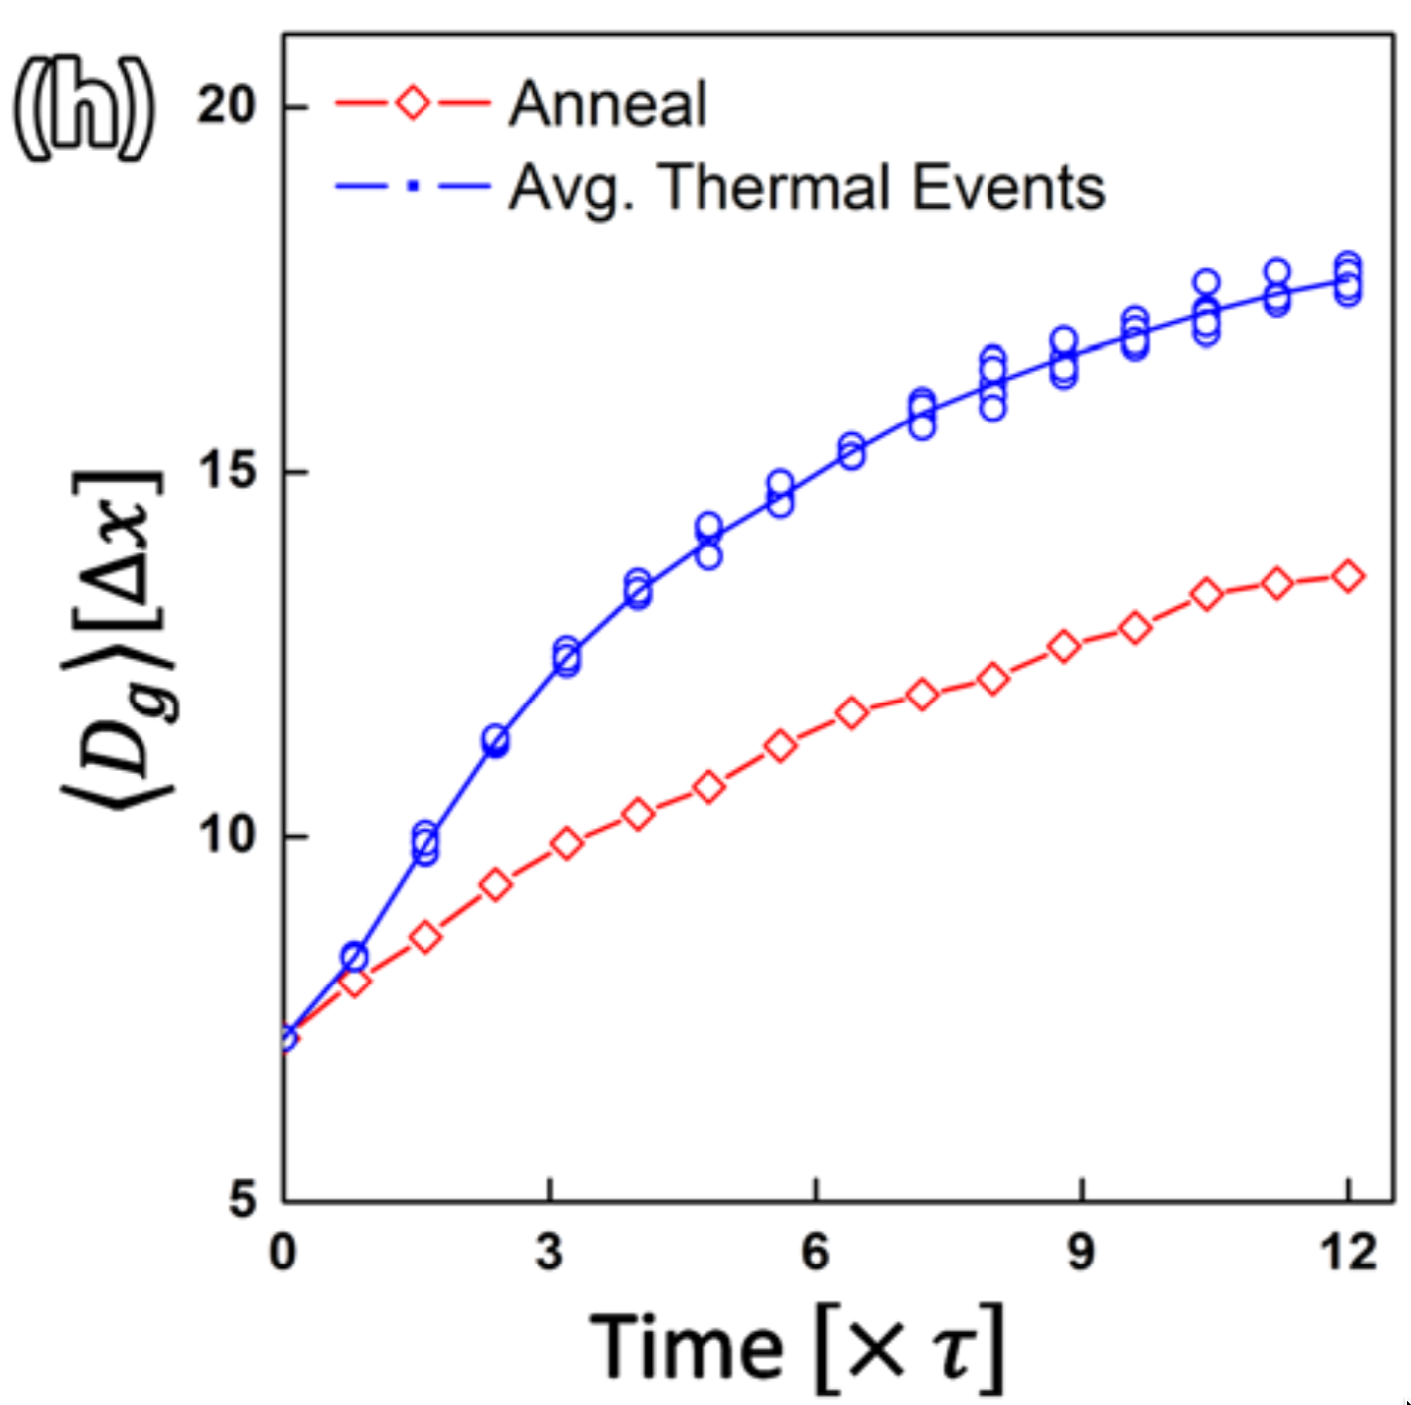
Irradiation can accelerate grain growth, but it is only significant with small grains and low temperature

Slide 17
Maximum grain size
Consider a material with an average grain size D
The change in D can be written as
k = 2 M_{GB} γ_{GB} is a rate constant that can be determined from experiments
D_{m} is the grain size at which the driving force equals the resistive pressure
For UO2:
D_{m} is a function of temperature microns

Slide 18
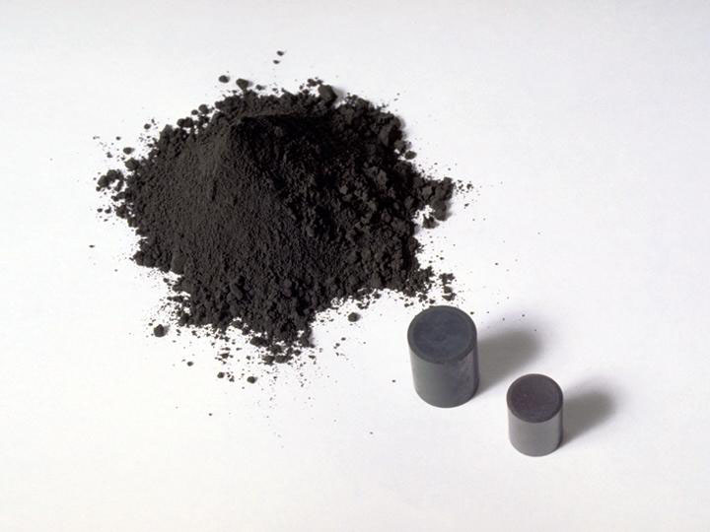
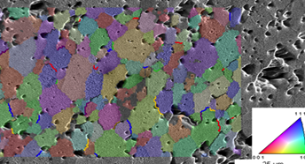
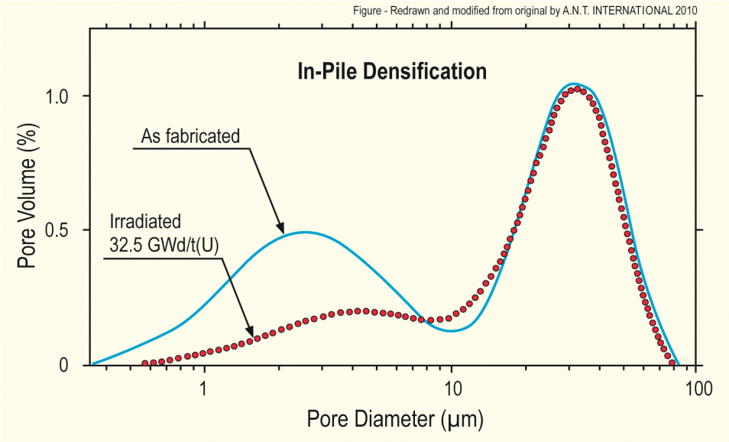
Fuel Densification
Remember that fresh fuel pellets are not fabricated to be 100% dense, more like 95-99% dense
Early in life, fuel pellets shrink and the initial porosity is largely eliminated
In some ways, densification is a continuation of the sintering process
However, irradiation accelerates the process
Small pores close due to effects of fission spikes and vacancy diffusion
Large pores stable (in absence of large hydrostatic stress)
Pellets with higher initial density, densify less

Slide 19
Densification
The driving force for densification is the change in free energy from the decrease in surface area of pores and lowering of the surface free energy
An empirical relation to describe densification has been built as a function of
β - Burnup (in FIMA)
Δρ₀ – Total densification that can occur ~ 0.01
β_{D} – Burnup at which densification stops ~5 MWD/kgU, ~0.005 FIMA
C_{D} = 7.235 − 0.0086 (T − 25) for T < 750C and CD = 1 for T ≥ 750C

Slide 20
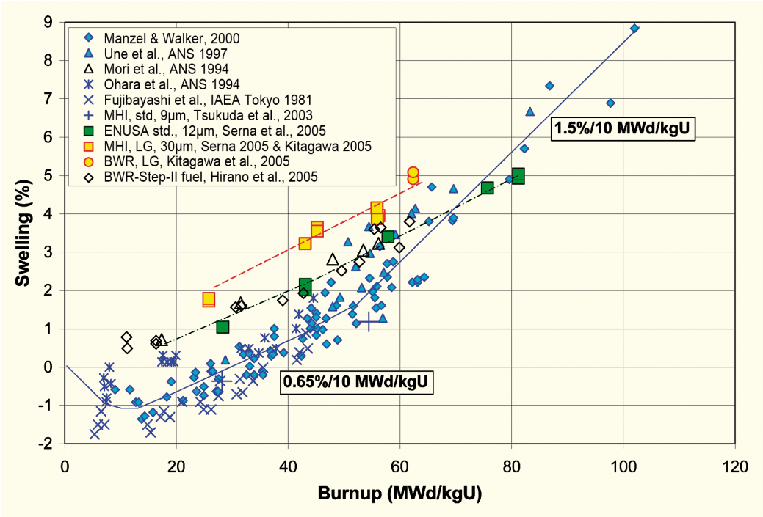
Empirical models
Many models of reactor fuel behavior are fits to experimental data
They are typically correlated to burnup
Burnup is a measure of how much fissioning has taken place. Typical units are:
MWD/kgU
FIMA
It can be calculated from the volumetric fission rate
Units of this equation are FIMA
To convert from FIMA to MWD/kgU, multiply by 950
after Garzarolli in [Rudling et al, 2007]

Slide 21
Summary
The average grain size in UO₂ impacts fuel behavior and performance:
Fission gas release
Swelling
Thermal conductivity
Creep
The material wants to reduce its energy by having large grains grow at the expense of small grains
Grain growth is reduced due to other defects reducing the grain boundary migration
Fuel densification is driven by reduction in surface area of pores – continuation of sintering process
Empirical models describe densification as a function of burnup

Slide 22
Notes
End of second section
Presentations Next Week
Problem Session 3/16
Exam 3/18

Slide 23
Fission products

Slide 24
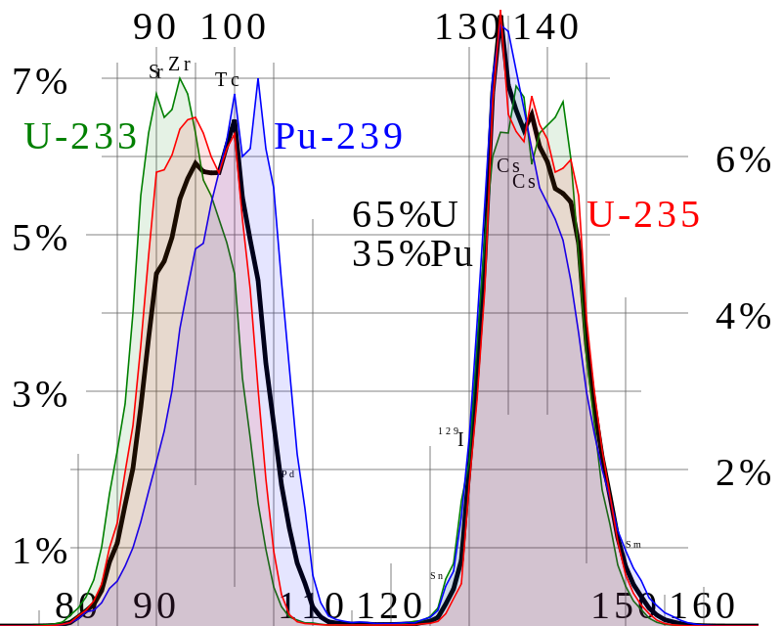
Fission Product Generation
Fission releases around 200 MeV
The fission fragments have 169 MeV of kinetic energy
2 to 3 neutrons with an average energy of 2 MeV
7 MeV of prompt gamma ray photons
The remaining energy is released by beta decay
Every fission product that is produced is now in the crystal lattice of the fuel, changing the microstructure

Slide 25
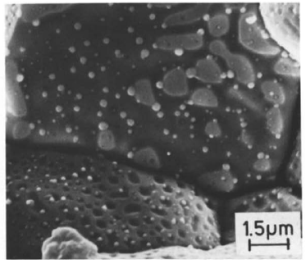
There are various types of fission products that form in the fuel
Soluble oxides (Y, La and the rare earths)
Dissolved in the cation sublattice
Insoluble oxides (Zr, Ba and Sr)
Form insoluble oxides in the fluorite lattice
Metals (Mo, Ru, Pd, and Tc)
Form metallic precipitates
Volatiles (Br, Rb, Te, I and Cs)
Exist as gases at high temperatures of the pellet interior
Also exist as solids at the cooler pellet exterior
Noble gases (Xe, Kr)
Essentially insoluble in the fuel matrix
Form either intragranular (within grain) voids or bubbles or intergranular (grain boundary) bubbles

Slide 26
All of the fission products impact the behavior of the fuel

Slide 27

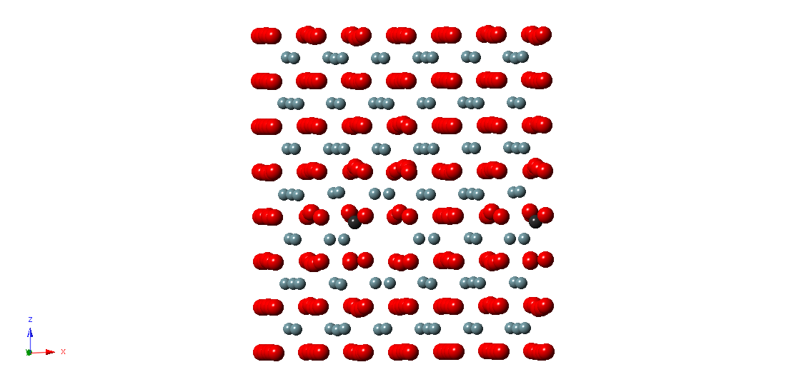
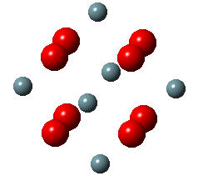
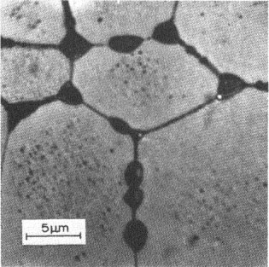
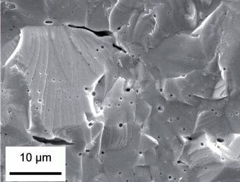
Fission Gas Release
Fission gases (Xe, Kr) are released in a process composed of three stages in UO2
Stage 1: Gas atoms are produced throughout the fuel due to fission and diffuse towards grain boundaries
Small intragranular bubbles form within the grains, but never get larger than a few nm radius due to resolution from energized particles
Gas atoms that don’t get trapped within the intragranular bubbles migrate to grain boundaries
Atoms forming a vacancy cluster

Slide 28
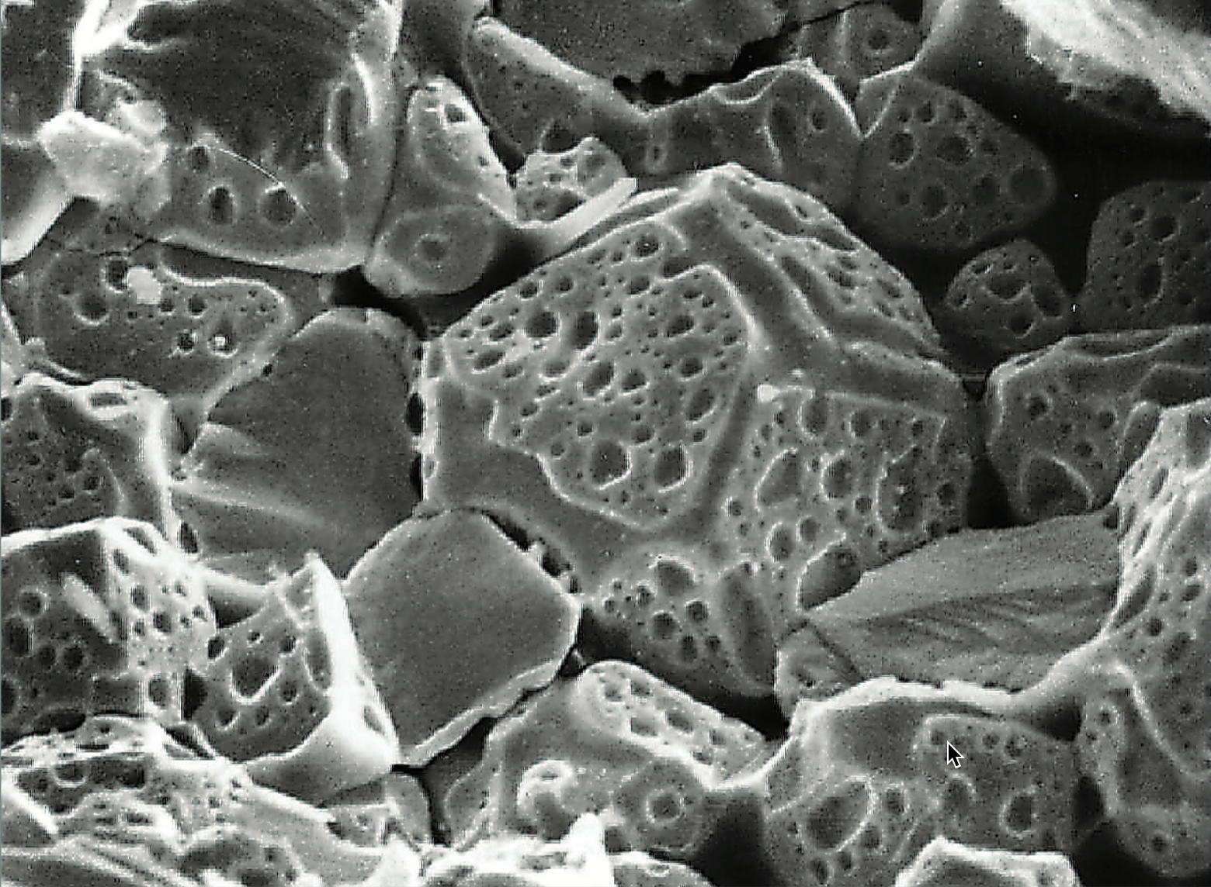
Fission Gas Release
Stage 2: Gas bubbles nucleate on grain boundaries, growing and interconnecting
Stage 3: Gas travels through interconnected bubbles to a free surface

Slide 29
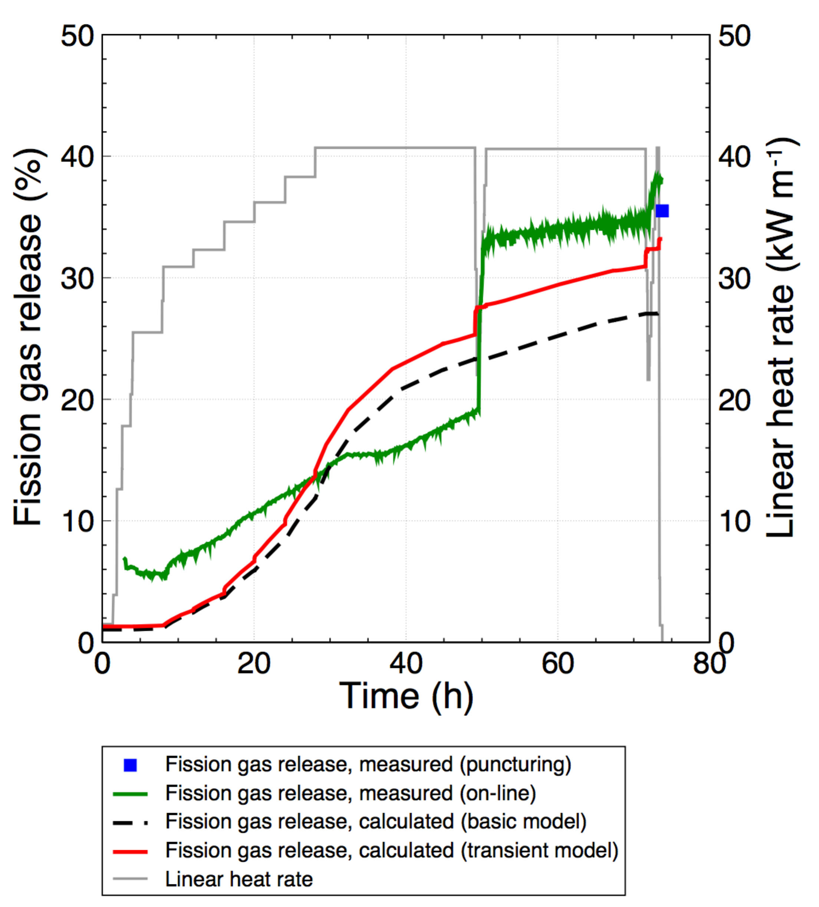
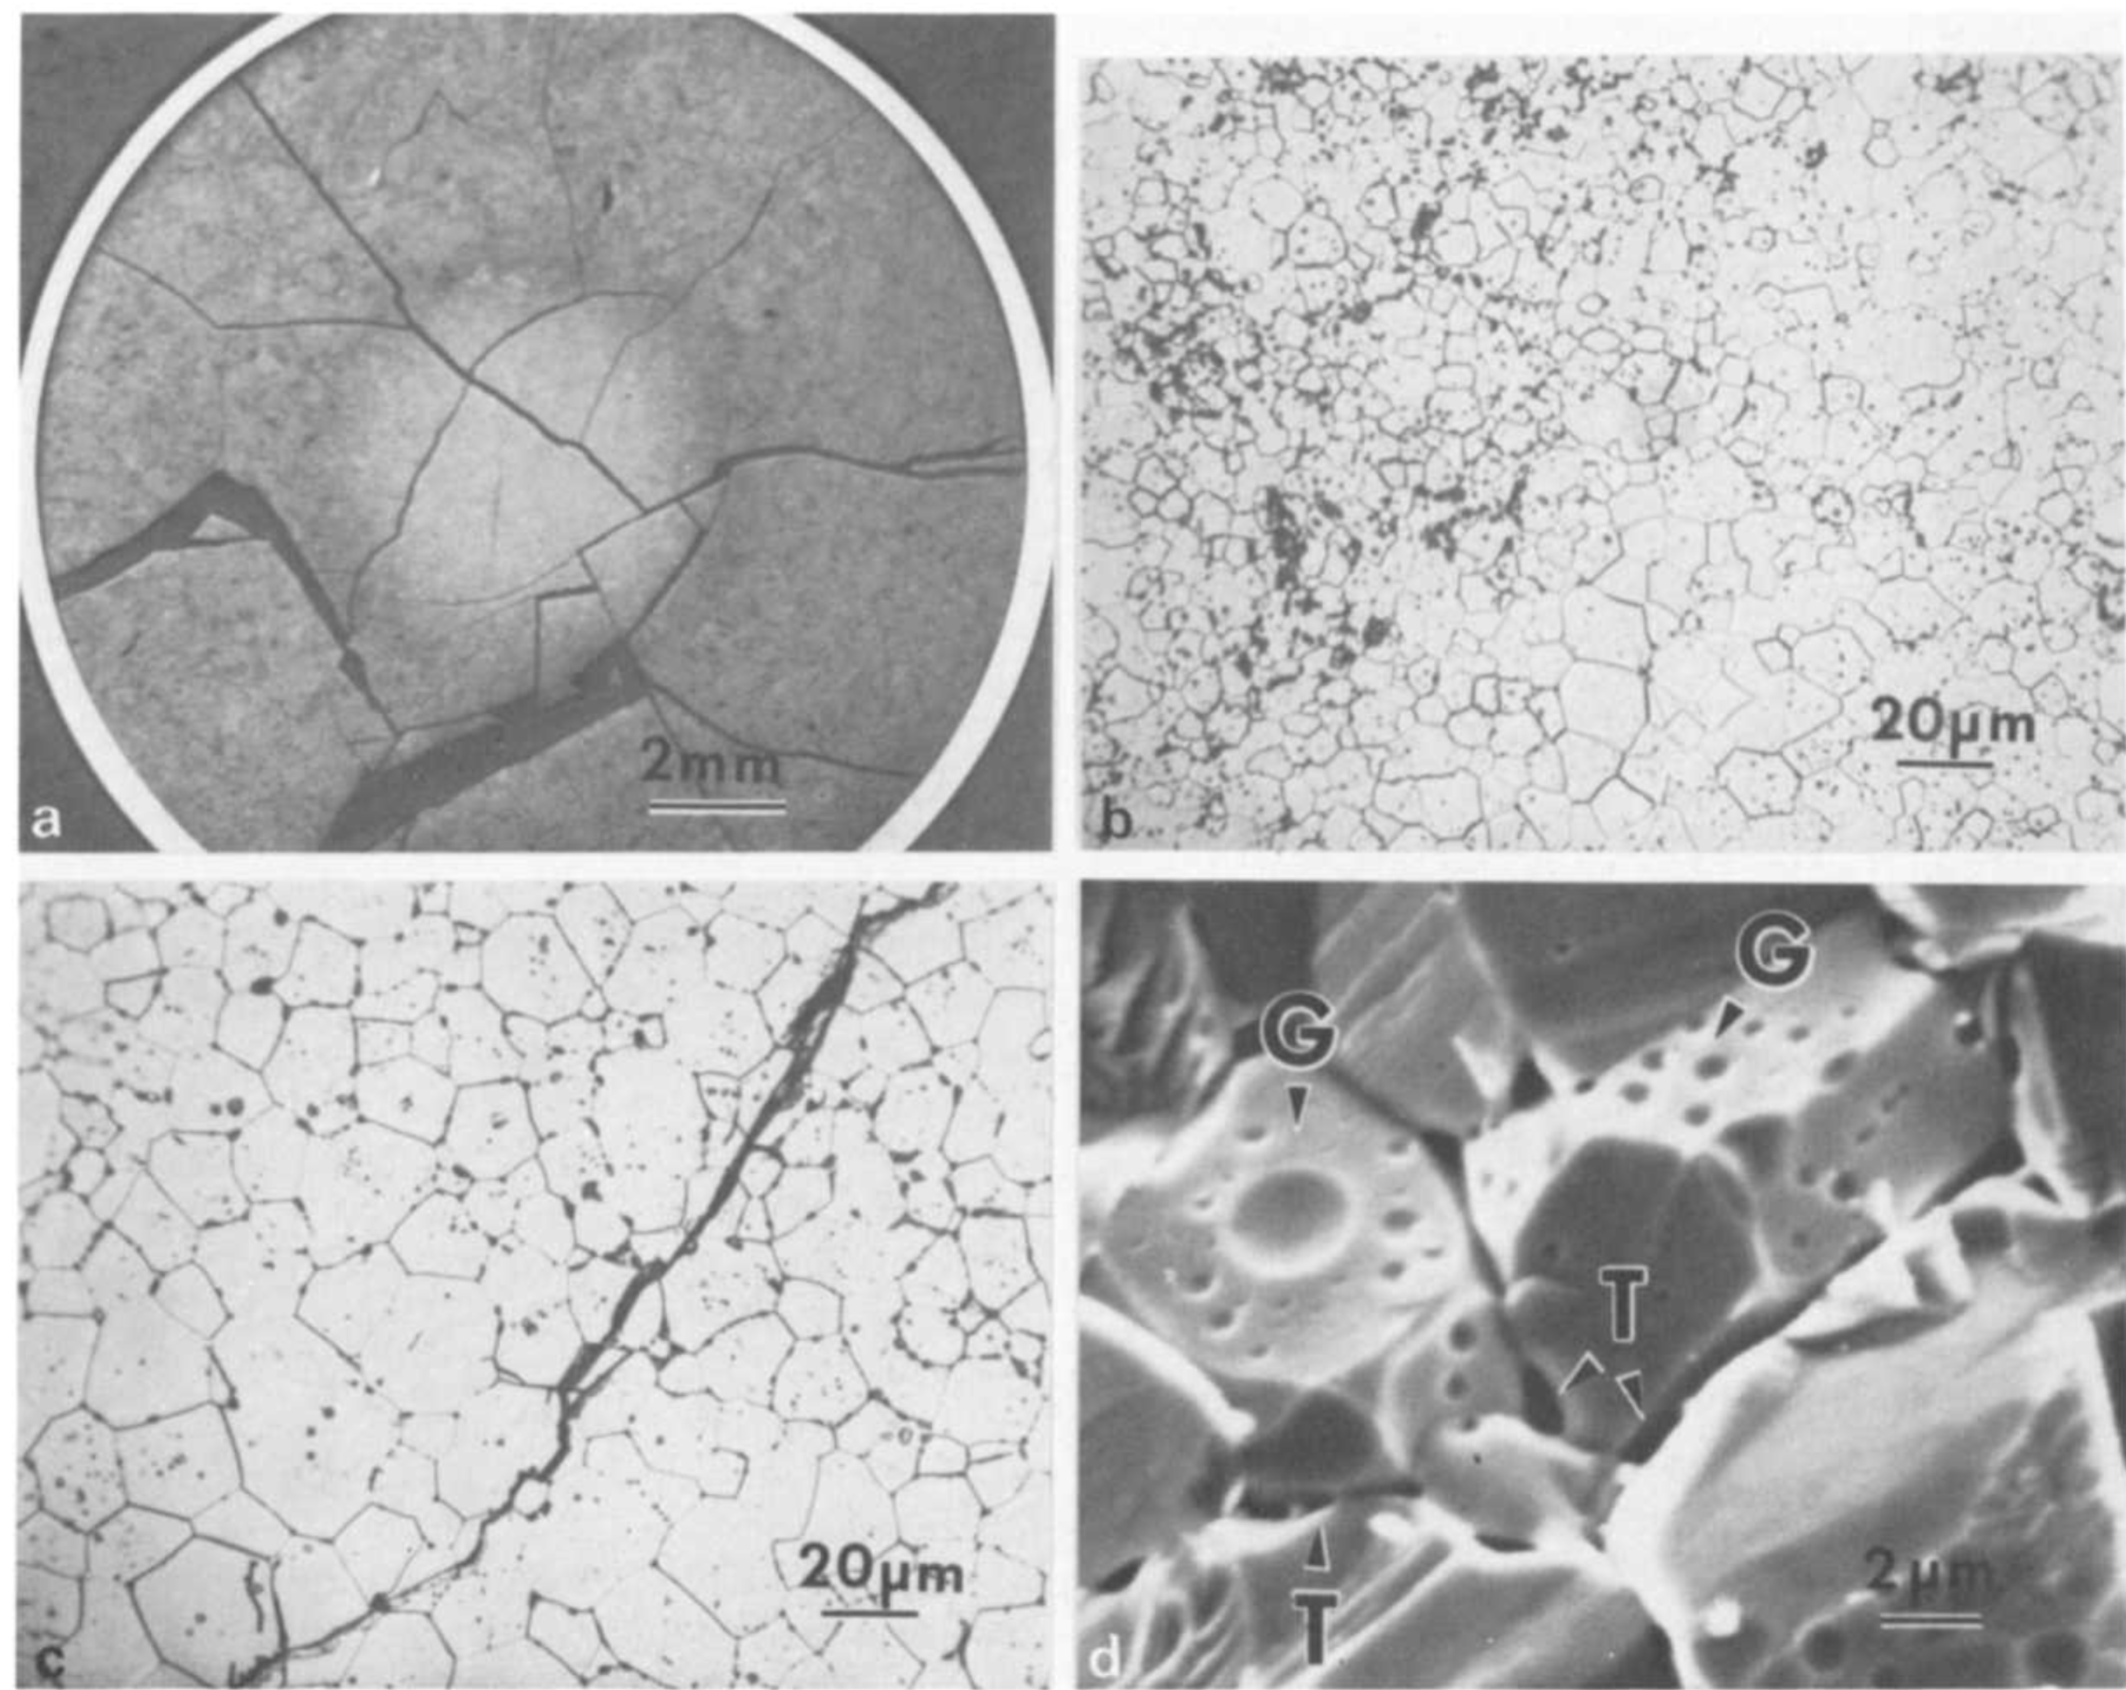
Fission Gas Release
Fission gas release also occurs due to mechanisms that don’t depend on diffusion
Release can occur to particle recoil and knockout at low temperature
It can occur due to fracture during rapid transients

Slide 30
Fission Gas Release
Released fission gas enters the gap and plenum, causing various problems
Xe and Kr have very low thermal conductivities, reducing the gap conductance
The plenum pressure increases
The volatile fission gases corrode the cladding
They are also radioactive and hazardous, causing problems when the cladding is breached
Fission gas release experiments:
Post irradiation annealing
Fuel is irradiated at low temperature
Fuel is then placed into a furnace and heated
Gas atom release is then measured
In-pile release
Gas release is measured during reactor operation
It is much more difficult than post-irradiation annealing
Total amount released is measured by puncturing cladding after irradiation
Release with time can be estimated using a pressure transducer inside an instrumented fuel rod

Slide 31
Fission Gas Release
Fission gas release models attempt to predict the rate at which gas is released from the fuel
To model fission gas release, ideally we must model all three stages of gas release
Diffusion of gas atoms to grain boundaries
Growth and interconnection of grain boundary bubbles
Transport of gas atoms through interconnected bubbles to free surfaces
The earliest models only considered Stage 1
Most models now consider stage 1 and 2
There are no models that consider all three stages, but some are under development

Slide 32
Booth Model
The Booth model is the earliest model of fission gas release and only considers stage 1
A grain is considered as a simple sphere
Gas atoms are released at the grain boundary
The model solves the diffusion equation in 1D spherical coordinates
Assumptions
c_{g}(r, t)
All grains are spheres of radius a
D is constant throughout the grain
Gas is produced uniformly throughout the grain
Gas is released once it reaches the grain boundary
Release
Gas atoms
Grain boundary
ICs and BCs
c_{g}(r, 0) = 0
c_{g,r}(0, t) = 0
c_{g}(a, t) = 0 (release)

Slide 33
Modeling post-irradiation annealing
The initial gas concentration is c_{g}⁰
No gas is produced
Solving this equation tells us the value of c_{g} at any radius or time
However, we want to know the fraction of gas atoms that have made it to the grain boundary
We use the flux at the grain boundary
Release
Gas atoms
Grain boundary
ICs and BCs
c_{g}(r, 0) = c_{g}⁰
c_{g,r}(0, t) = 0
c_{g}(a, t) = 0 (release)

Slide 34
Solving the Booth Model
This equation is solved using a Laplace transform after nondimensionalization
Will not go through the derivation (shown in Olander)
τ = D x t / a²
Release
Gas atoms
Grain boundary
τ < π⁻²
τ ≥ π⁻²

Slide 35
Booth Example
For a diffusion coefficient for Xe of D = 8e-15 cm²/s, what fraction of the fission gas trapped in an post-irradiation annealed fuel pellet has escaped after one hour? It has an average grain size of 10 microns
D = 8e-15 cm²/s
a = 10e-4 cm
t = 3600 s
Which f? τ = D x t/a² = 2.88E-4 < π⁻² = 0.101
f = 6*sqrt(8e-15*3600/(pi*(10e-4)^2)) – 3*8e-15*3600/(10e-4)^2 = 0.0181

Slide 36
Different expressions for fission gas release
Given the data from the previous example, can plot both
τ < π⁻²
τ > π⁻²

Slide 37
Modeling in-pile release
The initial gas concentration is 0
Gas is produced due to fission, where y is the chain yield (y = 0.3017 for Xe and Kr) and the fission rate
Gas can also decay, where λ is the decay constant
If we only consider stable stable products, λ = 0
For in pile release, the fraction is equal to
After solving with with a Laplace transform
The total gas production is gas atoms/cm³
Release
Gas atoms
Grain boundary
ICs and BCs
c_{g}(r, 0) = 0
c_{g,r}(0, t) = 0
c_{g}(a, t) = 0 (release)

Slide 38
Example
For a diffusion coefficient for Xe of D = 8e-15 cm²/s, what fraction of the fission gas trapped in an in-pile fuel pellet has escaped after one hour? It has an average grain size of 10 microns.
D = 8e-15 cm²/s
a = 10e-4 cm
We have a short time (t=3600 s), so we can use:
f = 4*sqrt(8e-15*3600/(pi*(10e-4)^2)) – 3/2*8e-15*3600/(10e-4)^2 = 0.0121

Slide 39
Gas release
We have calculated the fraction, but how much gas was actually released?
Consider 3% enriched UO₂ with a thermal fission cross section of U-235, σ_{f235} = 570 barns or 570 × 10⁻²⁴ cm² and a density of UO2, ρ_{U} = 10.97 g/cm³.
What would be the number of fission gas atoms released after one hour with a neutron flux of 3×10¹³ n/(cm² s) from a pellet of radius 0.5 cm and height 1.2 cm?
Molar mass of 3% enriched UO2: 235*0.03 + 238*0.97 + 2*16 = 269.9 g/mol
Atom density of U-235 = 10.97 x 1/269.9 x 6.022E23 x 1/1 x 0.03 = 7.34E20 atoms/cm³
First, we have to calculate the fission rate: Fdot = 7.34E20*570E-24*3e13 = 1.26E13 fissions/(cm³ s)
Next we calculate the total amount of fission gas produced
N_{FG} = y Fdot t = 0.3017*1.26E13*3600 = 1.36E16 fission gas atoms/cm³
Vol = π r² h = pi*0.5^2*1.2 = 0.94 cm³
NFG*Vol = 1.36E16*0.94 = 1.28e16 fission gas atoms
Finally we calculate the total amount of gas released using the fraction
f = 0.0121
Gas released = 0.0121*1.28e16 atoms produced = 1.55e14 atoms released

Slide 40
As time progresses, both the fraction released and the produced gas increase

Slide 41
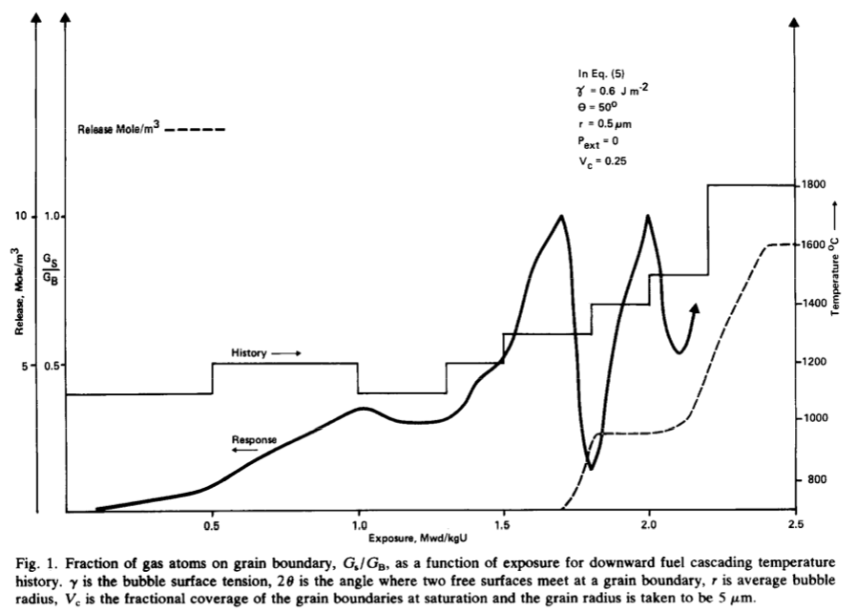
Forsberg-Massih model
The Booth model ONLY considers stage one of fission gas release
Two stage Forsberg-Massih mechanistic model
Considers intragranular diffusion diffusion to grain boundaries (stage 1)
Also, grain boundary gas accumulation, resolution back into grain, saturation (stage 2)
Assumes that once the bubbles on the grain face are interconnected, it is released (no stage 3)

Slide 42
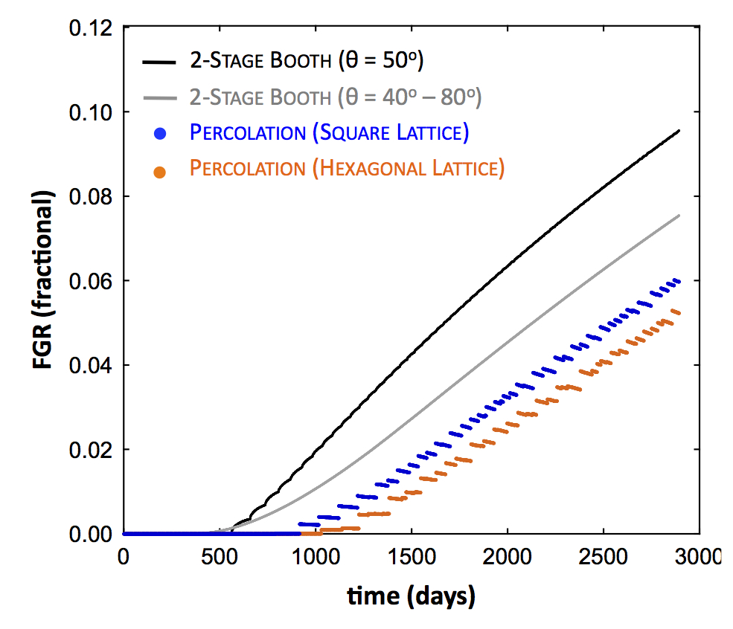
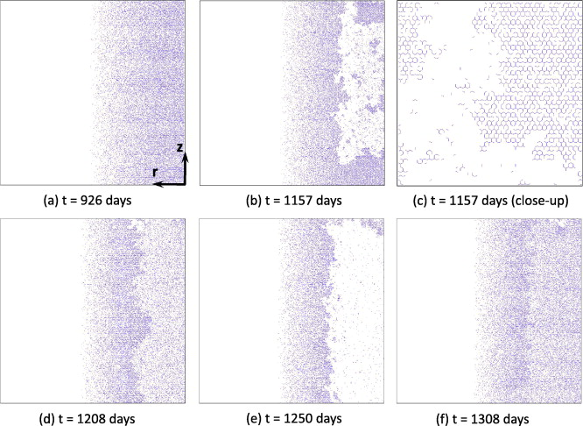
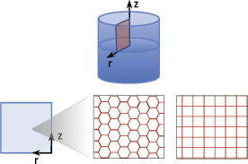
Forsberg-Massih model
2-stage F-M model over-predicts gas release because it neglects grain boundary bubble percolation (Stage 3)
Millett, Tonks, and Biner. JNM, 424.1 (2012): 176-182.

Slide 43
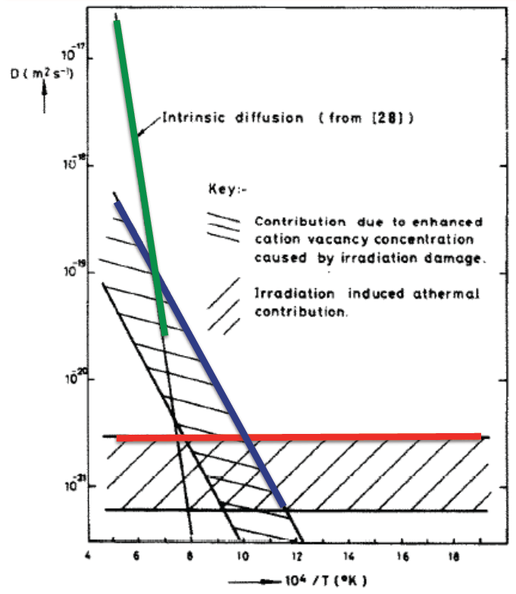
Gas diffusion
The diffusivity of the fission gas depends on temperature and on irradiation
Experimental data shows three different regimes for the diffusivity
D = D₁ + D₂ + D₃ cm²/s

Slide 44
Gas diffusion
The effective fission gas diffusivity is slower due to trapping by intragranular bubbles
As the gas atoms diffuse towards the grain boundary, some are trapped by the small intragranular bubbles
Some are later knocked out by energized particles (called resolution)
The effective diffusion constant depends on the trapping rate r_{t} and the resolution rate r_{r}

Slide 45
Summary
Fission products change the fuel behavior
Fission gas is released in three stages
Fission gas production and diffusion to grain boundaries
Grain boundary bubble nucleation, growth, and interconnection
Gas transport through interconnected bubbles to free surfaces
Fission gas release is measured using post-irradiation annealing and/or in pile experiments
Fission gas release models are used to understand fission gas experiments and to predict gas release for fuel performance codes
Spherical grain models predict a fraction of gas release for post-irradiation annealing or for in-pile gas release
Fission gas diffusivity behavior changes with temperature and fission rate

